Slide 1



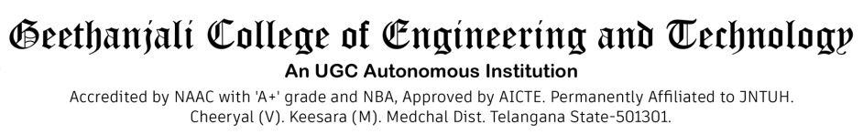
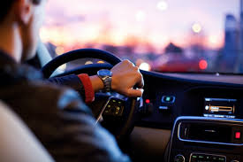

CNN-LSTM Driving Style Classification Model Based on Driver Operation Time Series Data
Team B6
Rekula Lahari (21r11A6686)
Guide:T.Santhosha

Slide 2


Table Of Contents
Introduction
Motivation
Problem Statement
Objectives
System Requirements
Technologies Used
Methodology
Limitations
Applications
Future Enhancements
Conclusion

Slide 3
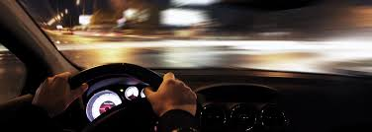
Introduction
The CNN-LSTM model is a hybrid deep learning architecture designed to classify driver behavior based on time-series data.
This model combines Convolutional Neural Networks (CNN) for feature extraction and Long Short-Term Memory (LSTM) networks for sequential pattern recognition.
Helps in identifying aggressive, normal, and cautious driving patterns using vehicle telemetry data(Automatic collection and transmission data from moving sources).

Slide 4

Motivation
Rising concerns over road safety and accident prevention.
Traditional driving monitoring systems lack real-time and adaptive learning capabilities.
AI-based driver behavior analysis can assist in accident prevention, insurance claims, and autonomous driving enhancements.
The need for real-time driving pattern recognition for intelligent transportation systems.

Slide 5
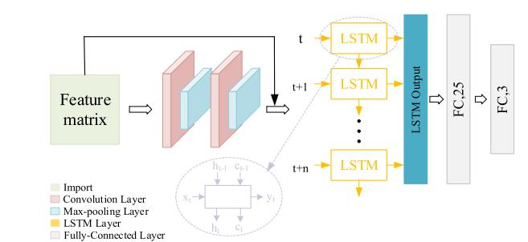
Problem Statement
Existing driving behavior classification models rely on predefined rule-based algorithms.
Traditional methods fail to adapt dynamically to varying driving styles.
Inability to efficiently process high-dimensional time-series data from sensors.
Need for a robust AI-driven system that can analyze and classify driver behavior in real time.

Slide 6
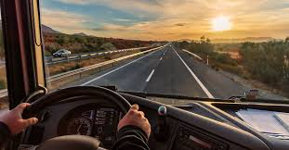
Objectives
Develop an AI-driven system to classify driver behavior using CNN-LSTM models.
Improve accuracy in driver classification through hybrid deep learning techniques.
Implement real-time monitoring for driver behavior analysis.
Enable cloud-based processing for scalability and efficiency.

Slide 7
System Requirements
Hardware Requirements:
GPU: NVIDIA RTX 3080 or higher
Sensors: Accelerometers, Gyroscopes, GPS
Storage: SSD (500GB+) for fast data access
Software Requirements:
Python, TensorFlow, Keras, OpenCV
Database: MySQL / MongoDB
API Integration for cloud-based processing
DataSets
DMD-Driver Monitoring Dataset
Self-Collected Real-World Driving Dataset
UDD-Urban Driving Dataset

Slide 8
Technologies Used
CNN (Convolutional Neural Network): Extracts spatial features from sensor data.
LSTM (Long Short-Term Memory): Captures time-dependent patterns in driving behavior.
GRU (Gated Recurrent Unit): A varient to LSTM for sequence learning.
GPS & IoT Sensors: Real-time telemetry data collection.
AWS & Cloud Computing: Scalable deployment and real-time analytics.

Slide 9
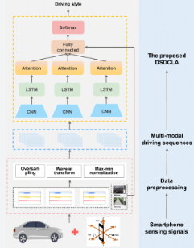
Methodology
Data Collection:Gather sensor data from vechiles (speed ,acceleration,GPS)
Data Preprocessing:Remove noise,normalize values and create time-series input.
CNN for Feature Extraction: Extracts patterns from vehicle sensor data.
LSTM for Temporal Analysis: Identifies trends in driving behavior over time.
Model Training: Reduces false positives and enhances predictive reliability.
Real-Time Prediction: Enables real-time data analysis for fleet management.

Slide 10
Comparison
Company | Current Driver Behavior Tech | CNN-LSTM Model | Key Difference
Uber | GPS tracking, basic accelerometer data, rule-based thresholds, AI alerts (non-deep learning in most tiers). | Combines CNN for spatial feature extraction + LSTM for temporal behavior trends from telemetry data. | CNN-LSTM enables deep, adaptive, real-time pattern learning, unlike rule-based detection.
Ola | GPS tracking, in-app reports, basic AI flagging, limited machine learning. | Real-time, sensor-driven telemetry processing via deep learning. | CNN-LSTM can process rich time-series sensor data which is not deeply leveraged in Ola.
Rapido | Uses basic trip data and user feedback to assess driver behavior. | Uses multiple sensor types (gyro, GPS, accelerometer) for real-time analytics. | Traditional companies rely heavily on post-trip analysis; CNN-LSTM works in real-time.
Zoomcar | Vehicle diagnostics, GPS, speed threshold alerts. | Sequential modeling to detect nuanced behavior types (aggressive, normal, cautious). | CNN-LSTM distinguishes between subtle driving styles over time; rule-based cannot.
Bounce | Focus on vehicle data (battery, GPS) rather than driver style; light ML. | Deep behavioral profiling from live vehicle signals. | CNN-LSTM gives more personalized driver classification for safety and insurance.

Slide 11
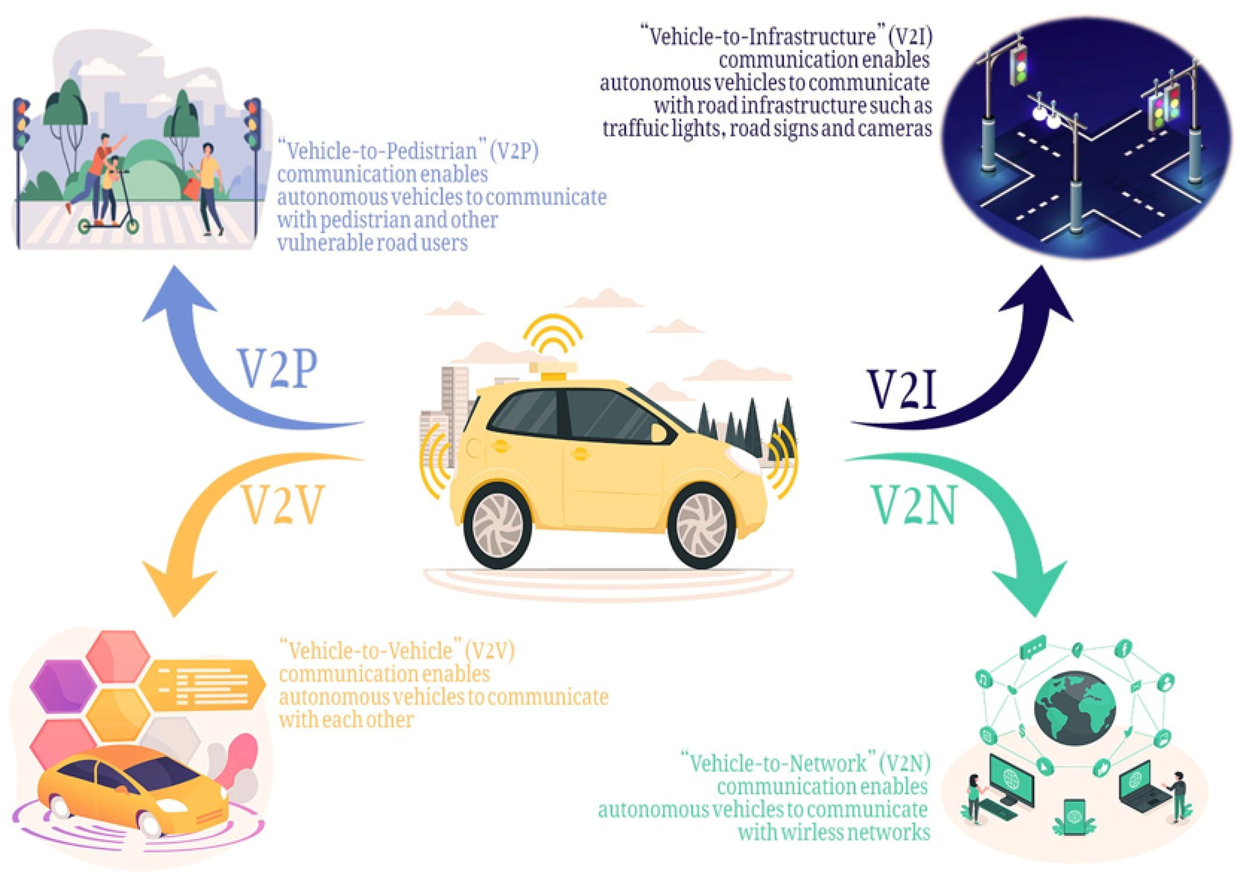
Limitations
High computational requirements for deep learning models.
Dependence on high-quality sensor data for accuracy.
Challenges in real-time deployment due to processing latency.
Need for large labeled datasets for effective training.

Slide 12
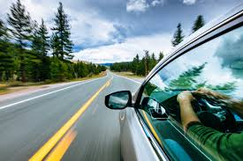
Applications
Driver monitoring for accident prevention.
Insurance-based risk assessment (UBI - Usage-Based Insurance).
Fleet management for commercial vehicles.
Intelligent Transportation Systems (ITS) and V2X communication.

Slide 13
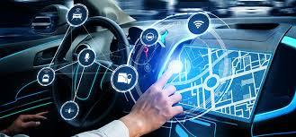
Future Enhancements
Integration with autonomous vehicle systems:Making it more suitable for self-driving.
Transformer models:Enhancing sequential learning accuracy.
Deployment in real-time edge AI:Reducing reliance on cloud computing.
Expansion to multi-modal data sources:Incorporrating speech, video and biometric data for better driver classification).
Integration with autonomous vehicle systems.
Improved accuracy using Transformer models.
Deployment in real-time edge AI environments.
Expansion to multi-modal data sources (speech, video).

Slide 14
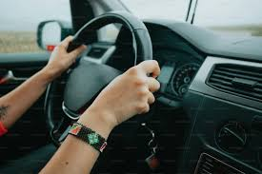
Conclusion
CNN-LSTM hybrid models enhance real-time driver behavior classification.
Helps in real-time driving monitoring and accident prevention
The model is useful for the fleet management,improving insurance assessments, and aiding autonomous driving.
Future improvements will focus on increasing accuracy and real-world applicability.

Slide 15



Thank
YOU

